Slide 1
Advanced Analytical Chemistry 1
Separation Technique, Chromatography
For Postgraduate (Master's degrees)
Lecture No. 2
By
Asst. Prof. Dr. Layla Salih Al-Omran

Slide 2
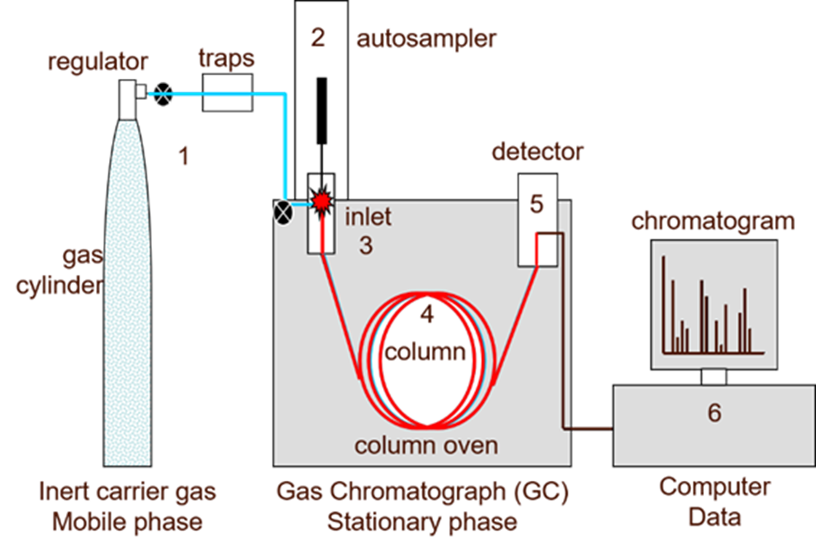

Slide 3
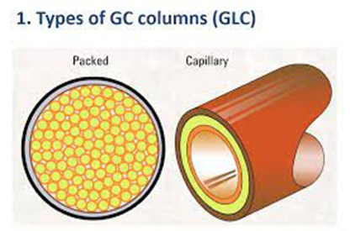
3 . Separation column
Columns/stationary phases are responsible for the separation process. In the GC system, a sample is vaporized and injected into the head of the column. There are two general types of column, packed and capillary column.

Slide 4
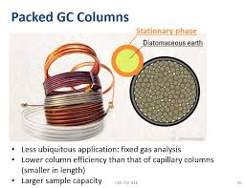
Packed column
Contains a fully-packed stationary phase made up of fine particles. this increases the pressure inside the column.
The three components of a packed column are the tubing, packing, and the end plugs
The packing or the stationary phase is either solid or liquid.
In the case of liquid stationary phase, the liquid phase coats the fine particles, while solid stationary phase is simply a packing of fine particles and there is no liquid phase covering the particles.

Slide 5
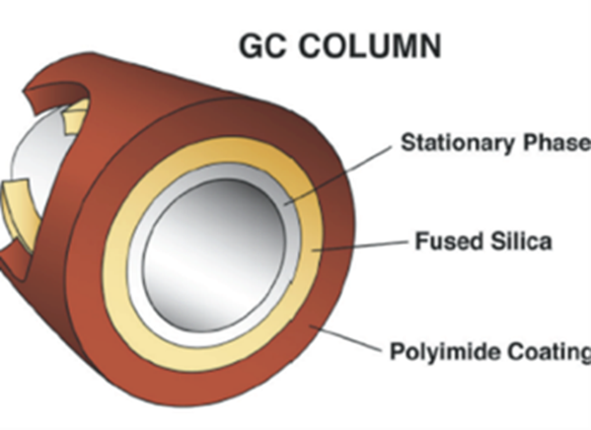
Capillary columns
Capillary columns (also known as open tubular) are
Other names for capillary columns are wall-coated open tubular (WCOT) columns or porous layered open tubular (PLOT) columns.
the stationary phase only coats the inner surface of the tube and a polyimide layer serves as the stationary phase. So, the whole column is not packed with the stationary phase.

Slide 6
Difference Between Packed Column and Capillary Column:
Packed columns has a packed stationary phase while capillary column is coated on the inner surface.
The packed columns require a large amount of the sample while the capillary column requires only a small.
Compared to the packed columns, the capillary columns have less pressure inside the column.
Packed columns are short while capillary columns are longer.
The diameter of the packed columns can be several millimeters while the diameter of the capillary columns is around 1 mm.
The efficiency of the packed columns is lower than the capillary columns.
packed columns give comparatively a poor resolution while capillary columns give a higher resolution.
Packed columns are less expensive while capillary columns are more expensive.
Packed columns are better for separating non polar samples since their tube is stainless steel while capillary columns are better for separating polar samples since their tube is glass.

Slide 7
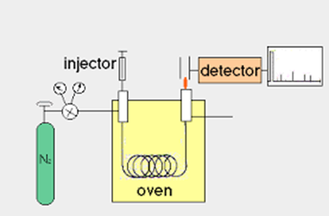
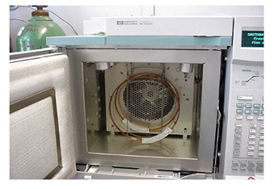
4- Oven or thermostat chambers
The oven is to control the temperature of the column to conduct precise work.
The oven can be operated in two manners: isothermal programming or temperature programming.
In isothermal programming, the temperature of the column is held constant throughout the whole separation.

Slide 8
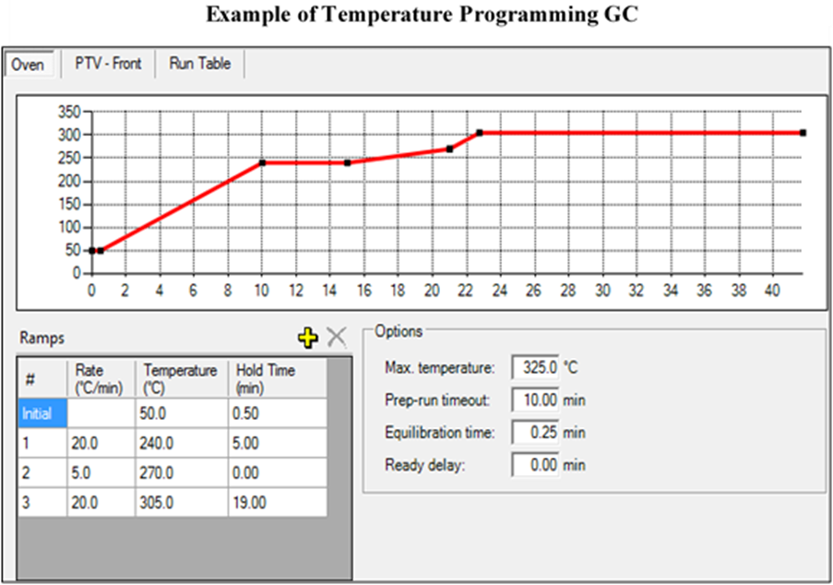
If the sample is complex mixture and separation is difficult, then the temperature can be varied so as to get better resolution/separation. This is called temperature programming.

Slide 9
5. Detectors
Since more and more complex mixtures can be successfully separated, subsequent chromatograms are increasingly more complex.
Therefore, the need to differentiate between the sample components using the GC detector.
Each detector has its own characteristics (selectivity, sensitivity, linear range, stability, cost, etc.) that helps in a decision about which detector to use.
Detectors sense the arrival of the separated components and provide a signal.
These are either concentration-dependent or mass dependent.
The detector should be close to the column exit and the correct temperature to prevent decomposition.

Slide 10
Most common types of detectors used in GC are:
a- Mass Spectrometer (MS)
b- Flame ionization detector (FID)
c- Thermal Conductivity Detector (TCD)
d- Electron capture detector (ECD)
e- Atomic emission detector (AED),
f-Photoionization detector (PID

Slide 11
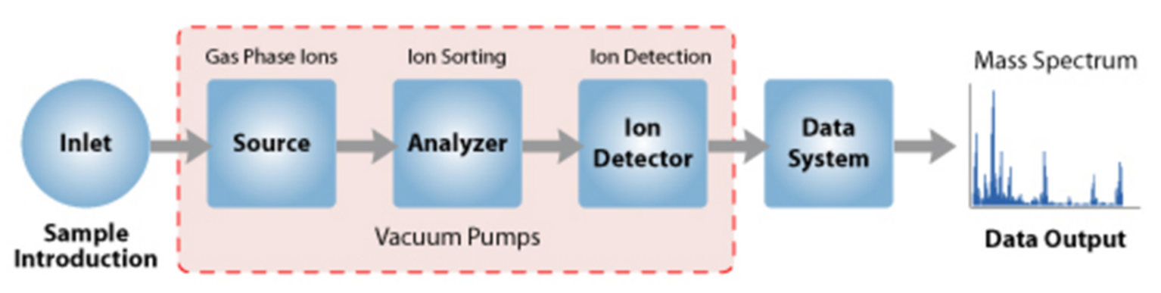
a- Mass Spectrometer (MS)
Analytic technique by which chemicals are identified by the sorting of gaseous ions in electric and magnetic fields according to their mass-to-charge ratios.
Ion source; converts gas phase molecules into ions.
Analyser; takes ionized masses and separates them based on charge to mass ratios and outputs them to the detector where they are detected then to output.
Ion detector; measures the value of an indicator and provides data for calculating the plenitude of present ions.

Slide 12
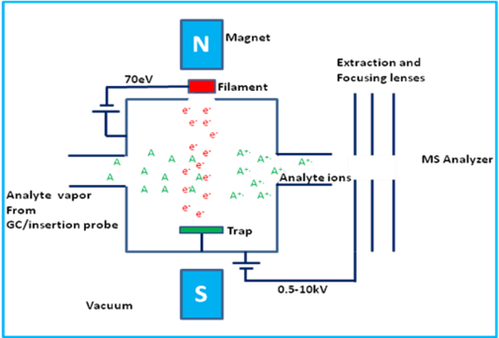
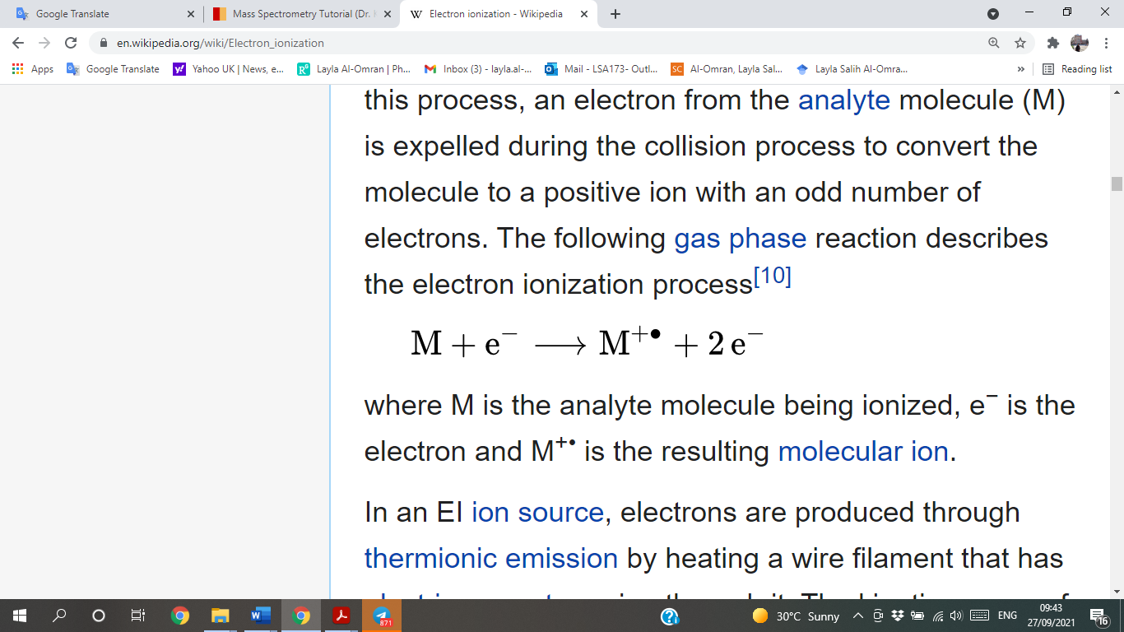
Modes of the ion source in MS spectroscopy
Electron Impact Ionization (EI)
EI delivers the highest energy to the analytes leading to ‘hard’ ionization and causes a large amount of molecular fragmentation.
M is the analyte molecule e− is the electron and M+• is the molecular ion.
Sample molecules in vapor state are bombarded by fast moving electrons-70 eV energy. One electron from the highest orbital energy is dislodged, and molecular ion are formed.
The unused electrons are collected by electron trap. To increase the ionization process, a weak magnetic field is applied parallel to the direction of the electrons' travel.

Slide 13
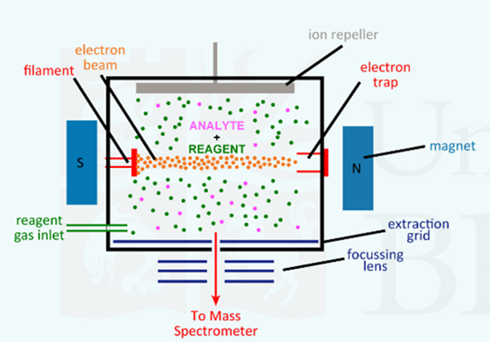
Chemical ionization (CI)
Useful when no molecular ion is observed in EI.
In CI reagent gas in used such as ammonia or methane that is the first subjected to electron to form reagent gas ions.
Molecular ions are formed by the interaction of reagent gas ions and sample molecules. This phenomenon is called ion-molecule reactions.
Positive ions and negative ions are formed in the CI process. Depending on the setup of the instrument (source voltages, detector, etc...) only positive ions or only negative ions are recorded.

Slide 14
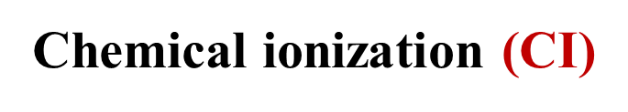
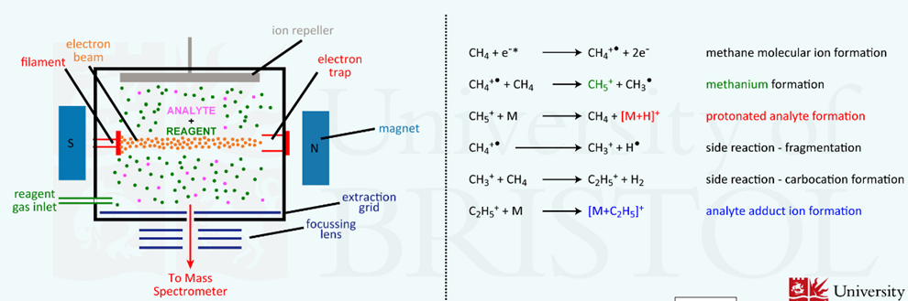

Slide 15
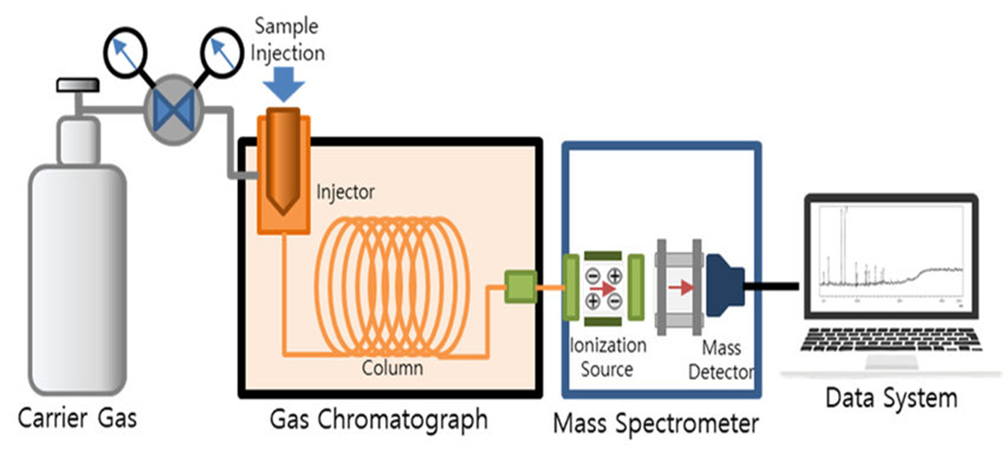
Gas Chromatography–Mass Spectrometry (GC–MS)
Ions that are too heavy or too light neutralized upon collision with the ring electrode wall.
Emitted ions then strike an electron multiplier which converts the detected ions into an electrical signal.
This electrical signal is then picked up by the computer through various programs.
As an end result, a chromatogram is produced representing the m/z ratio versus the abundance of the sample.

Slide 16
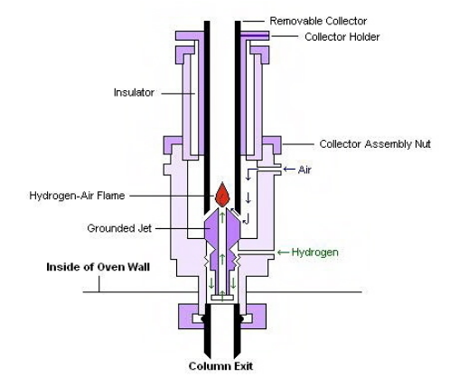
b- Flame ionization detector (FID)
The sample is directed at an air-hydrogen flame after exiting the column.
At the high temperature of the air-hydrogen flame, the sample undergoes pyrolysis, or chemical decomposition through intense heating
Used for almost all organic compounds, which have C-H or C-N structure. There are several exceptions such as CO, CO₂ and CS₂ which are non-organic compounds that cannot be detected. Carbonyl group and C=O carbon atom of carboxyl group are also not detectable.

Slide 17
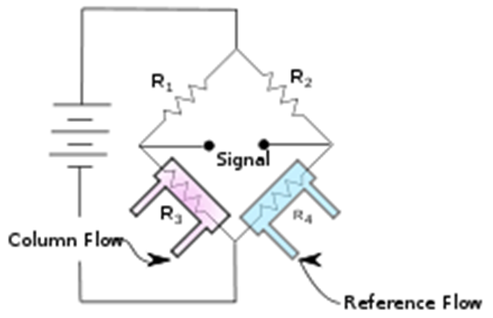
Thermal Conductivity Detector (TCD
using difference of thermal conductivity between the column flow (sample) and the carrier gas as a reference flow.
The compounds have a thermal conductivity less than of the carrier gases of helium or hydrogen.
when an analyte elutes from the column the effluent thermal conductivity is reduced, and a detectable signal is produced.
TCD can detect most compounds except for carrier gas but its sensitivity is not as high as compared to other detectors, such as the FID or BID, it has almost the lowest sensitivity. it can analyse the compounds that are undetectable using FID, such as water, formaldehyde, and formic acid.

Slide 18
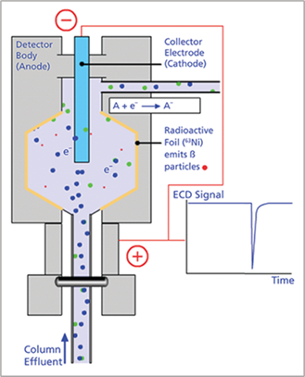
d- Electron capture detector (ECD)
Involves gaseous electrons from a radioactive emitter in an electric field.
As the analyte leaves the GC column, it is passed over this emitter, which typically consists of nickle-63 or tritium.
The electrons from the emitter ionize the carrier gas and cause it to release burst of electrons.
In the absence of organic compounds, a constant standing current is maintained between two electrodes.
With the addition of organic compounds with electronegative functional groups, the current decreases significantly as the functional groups capture the electrons.

Slide 19
e- Atomic emission detector (AED)
Is element-selective detectors that use plasma to atomize all of the elements of a sample, with a wider applicability due to its based on the detection of atomic emissions.
There are three ways of generating plasma: microwave-induced plasma (MIP), inductively coupled plasma (ICP) or direct current plasma (DCP).
The components of the Atomic emission detectors include 1) an interface for the incoming capillary GC column to induce plasma chamber,2) a microwave chamber, 3) a cooling system, 4) a diffraction grating that associated optics, and 5) a position adjustable photodiode array interfaced to a computer.

Slide 20
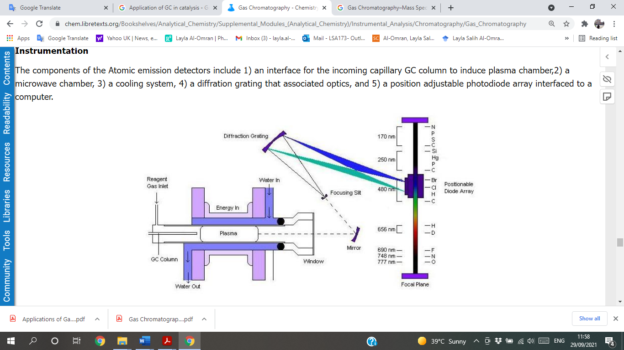
Atomic emission detector (AED)

Slide 21
f-Photoionization detector (PID
The sample stream flows through chamber where it is continuously irradiated with high-energy ultraviolet light.
Compounds that have an ionization potential lower than the irradiation energy (10.2 ev.) are ionized.
The ions formed are collected in an electrical field, producing an ion current that is proportional to compound concentration.
The PID selectively responds to aromatic and unsaturated hydrocarbons in the presence of alkanes and saturated hydrocarbons.

Slide 22
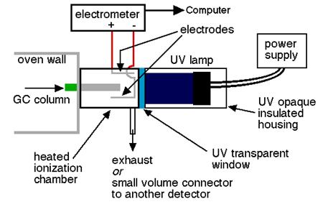
Photoionization detector (PID

Slide 23
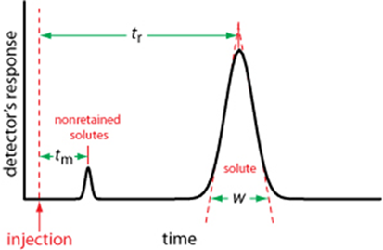
6- Amplification & Recorder system
The last & final components of GC instrumentation which record the signals that come from the detector.
The signals display in an understandable graphical format that represents several peaks of the constituents of the sample under analysis. These peaks are called a chromatogram.
Volume or time it takes for a analyte to come out from the column is known as retention volume or retention time tr. the baseline width, w.

Slide 24
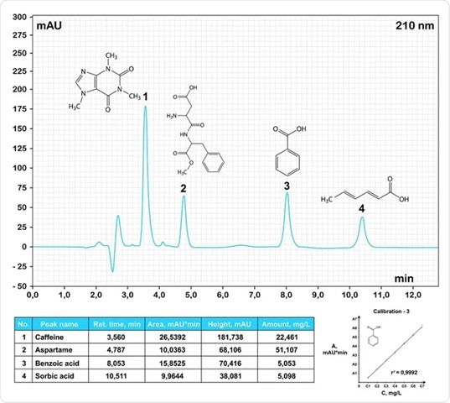
e.g. chromatogram

Slide 25
Application of gas chromatography
The application of gas chromatography to environmental analysis:
GC has significant role in the identification & quantification of pollutants of environment. It is used in the analysis of various classes of persistent organic contaminants in air, water, soils, sediments and biota. The organic pollutant groups like volatile organic compounds (VOCs); polycyclic aromatic hydrocarbons (PAHs); pesticides; and halogenated compounds such as polychlorinated biphenyl, terphenyls, organochlorine pesticides, and the brominated flame retardants, polybrominated biphenyls and polybrominated diphenylethers are analysed by GC.
In order to determine concentrations of chemicals, it is essential to reduce matrix complexity and by extraction and clean-up, then employ an appropriate analytical method such as GC-MS or LC-MS. In general, techniques for the determination of the environmental samples adhere to the following series of operations:
(1) extraction of the target compounds from the sample matrix,
(2) isolation of the compounds from co-extracted chemicals (Clean-up)
(3) concentration of the sample
(4) measurement using appropriate instrumental methods
Example: determination of brominated flame retardants in dust samples:

Slide 26
Example:
determination of brominated flame retardants in dust samples

Slide 27
Application of gas chromatography in food analysis:
Gas chromatography is widely used in food industry for ensuring the safety of food products, preventing contaminated products from becoming available for consumption. The technique is also essential to ensuring the quantity and quality of food products, ensuring that the flavor and taste, texture, and smell remain consistent. While other techniques are implemented by the food industry, gas chromatography remains a highly favored method due to its ease of use and cost-effectiveness.

Slide 28
GC analysis of petroleum products:
The petroleum products such as jet fuel petrol, diesel and kerosene are also analysed through GC. Test parameters involves column 16 degree per min. to 250 degree Celsius, detector – TCD, carrier gas – He, sample-jet fuel. GC analysis of water in gasoline is also done.

Slide 29
Additional applications.
• Identification of hazardous compounds in waste damps.
• Quantification of drugs & their metabolites in blood & urine.
• Identification of reaction products.
• Quantification of pollutants in drinking & waste water.
• Analysis of industrial products for quality control.
• Skin sample analysis.
• RNA isolation.

